Slide 1
School Health Advisory Board
Fall, 2013

Slide 2

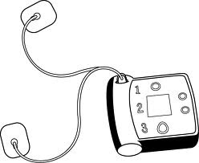
AEDs
We now have AEDs in all Albemarle County schools.

Slide 3
School-Based Immunizations: Tdap
Spring, 2013
Name of School | # of participants | # 5th grade students | Percentage
Scottsville | 13 | 41 | 32
Meriwether | 21 | 70 | 30
Agnor Hurt | 19 | 80 | 24

Slide 4
School-Based Immunizations:
Flu Shots, October 2013
School | # of participants | # of students | Percentage
Yancey | 8 | 149 | 5.5
Walton | 28 | 356 | 8
Murray High | 10 | 109 | 9

Slide 5
Albemarle County School Nurse/School Health Office Visit Report
School Year 2012-13
Clinic Visit Reason | SY 2012 - 2013
Feeling ill | 43,954
Minor injury | 20,960
Major injury | 81
Minor injury due to altercation | 233
Major injury due to altercation | 4
Repeat clinic visit for injury | 3,012
Miscellaneous Clinic Visits | 47,627
Students Given PRN Med | 22,889
Students Given Daily Med | 53,639
Students Sent Home | 7,808
Students Sent Home with Lice | 133
Students Referred to Doctor | 1,161
Rescue Squad Summoned | 44
Employee Clinic Visit | 2,725
Parent Contact | 22,432
Total Daily Clinic Visits | 164,499
Average Number of Daily Visits | 940
Enrollment | 12991

